Slide 1


Incognito
PROBLEM - 6
CICD Pipeline

Slide 2


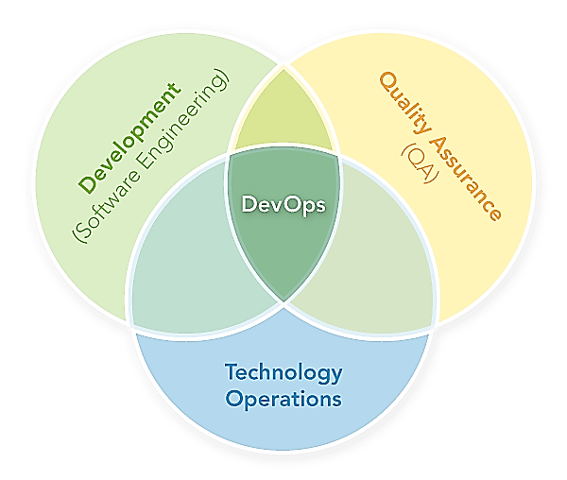
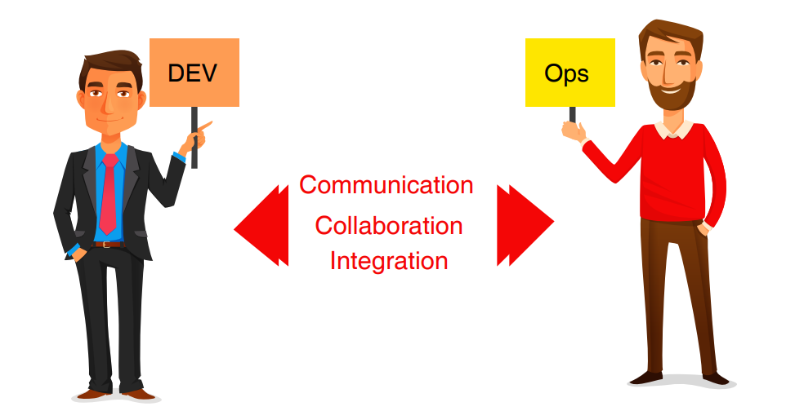
DEVOPS - PURPOSE
Communication and collaboration between product management, software development, and operations professionals.
04
Complete Automation from Development to final Deployment in Production done by IT Ops

Slide 3
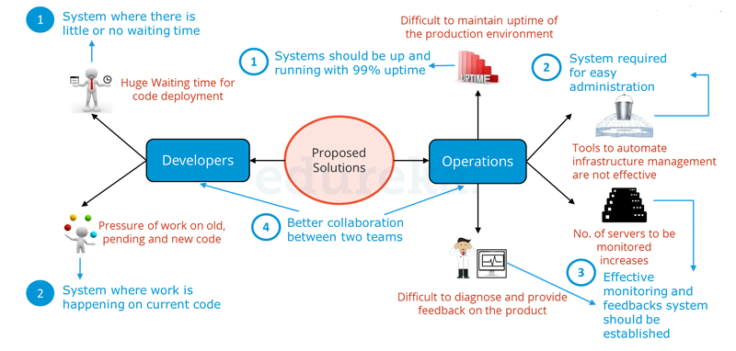
Why DEVOPS
04

Slide 4
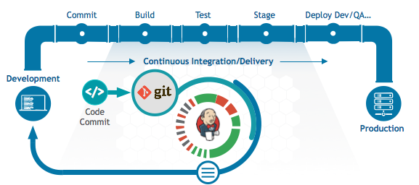
CICD Workflow
04

Slide 5
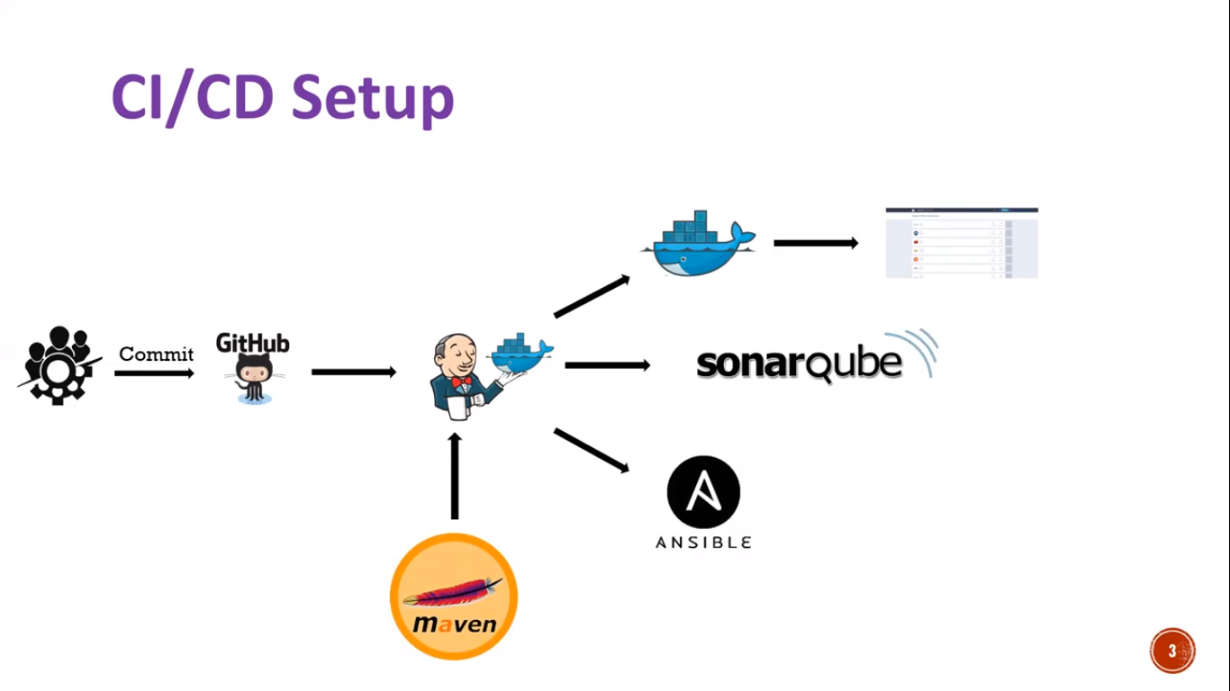
CICD - SETUP
04

Slide 6
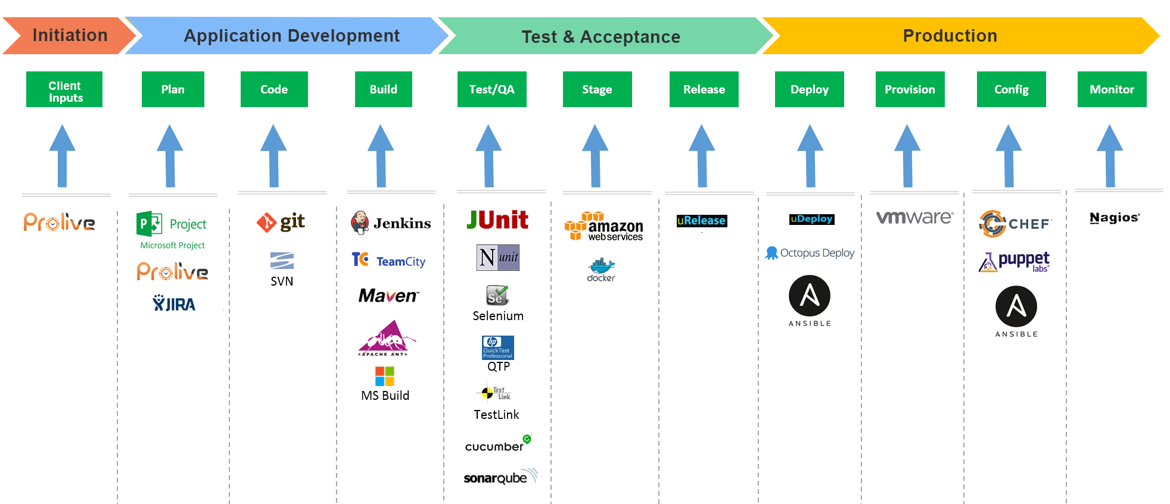
DEVOPS - TOOLS
04

Slide 7
TOOLS INVOLVED
JENKINS – Automation Server
MAVEN–Build dependency
JUNIT– Running test cases
SONARQUBE– Static code analysis
EMAIL– Push Notification
TOMCAT– Application Deployment
04

Slide 8
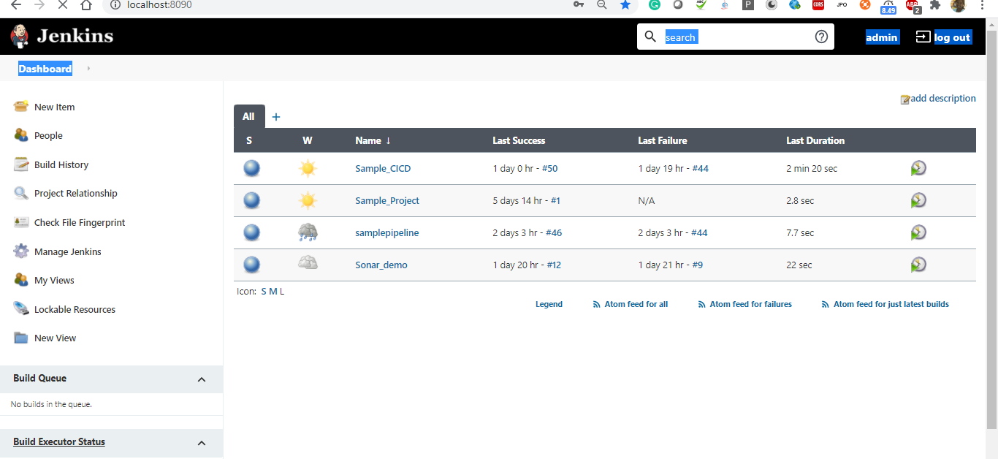
Build , Test , Deploy - JENKINS
04

Slide 9
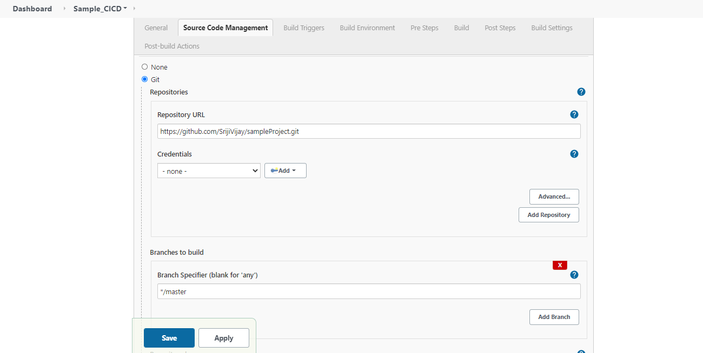
Source Code Management- GIT
04

Slide 10
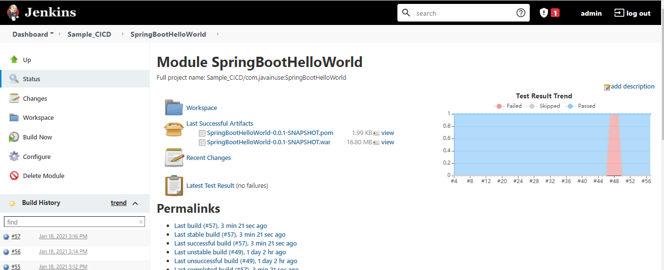
Unit Testing - JUNIT
04

Slide 11
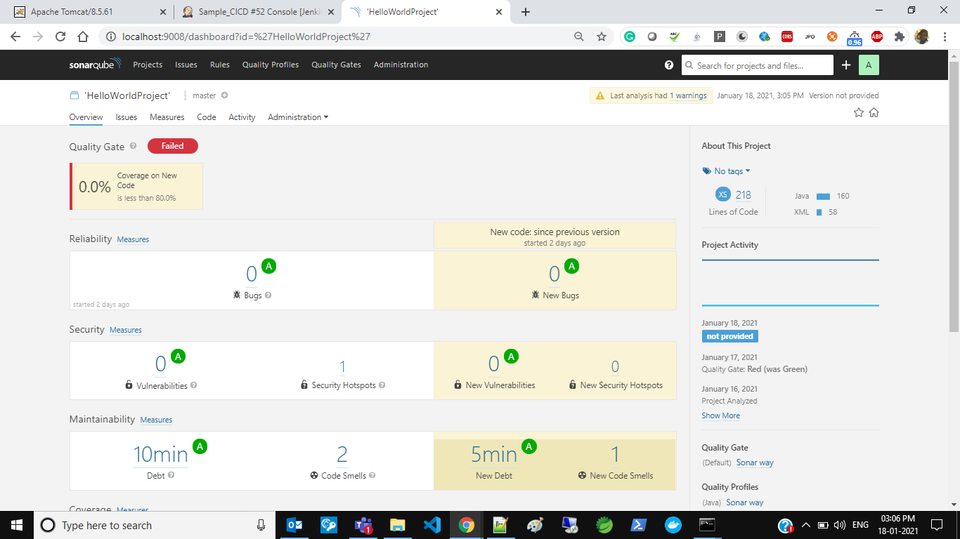
Static Code Analysis - SONARQUBE
04

Slide 12
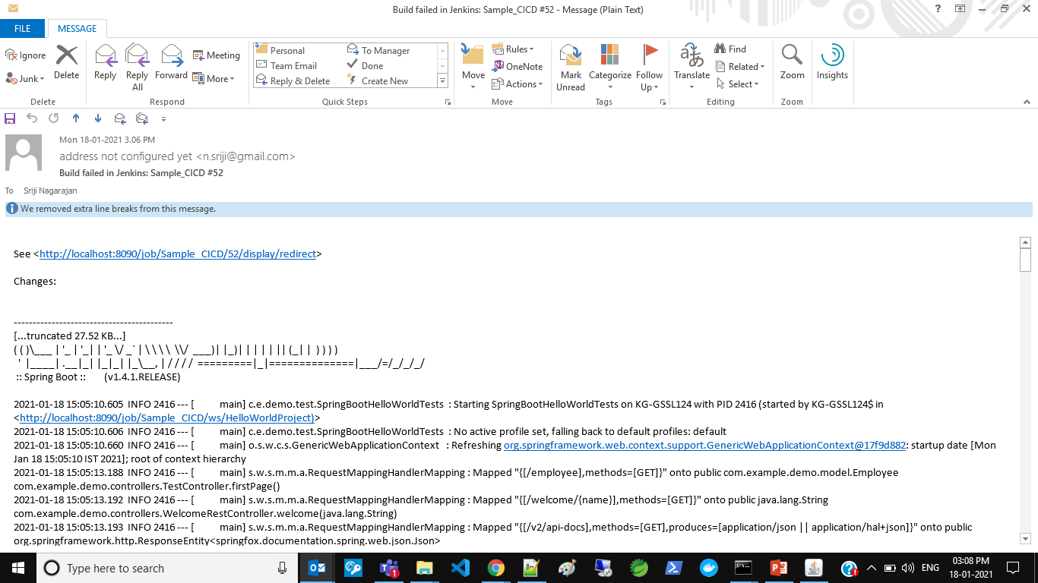
Push Notification- EMAIL
04

Slide 13
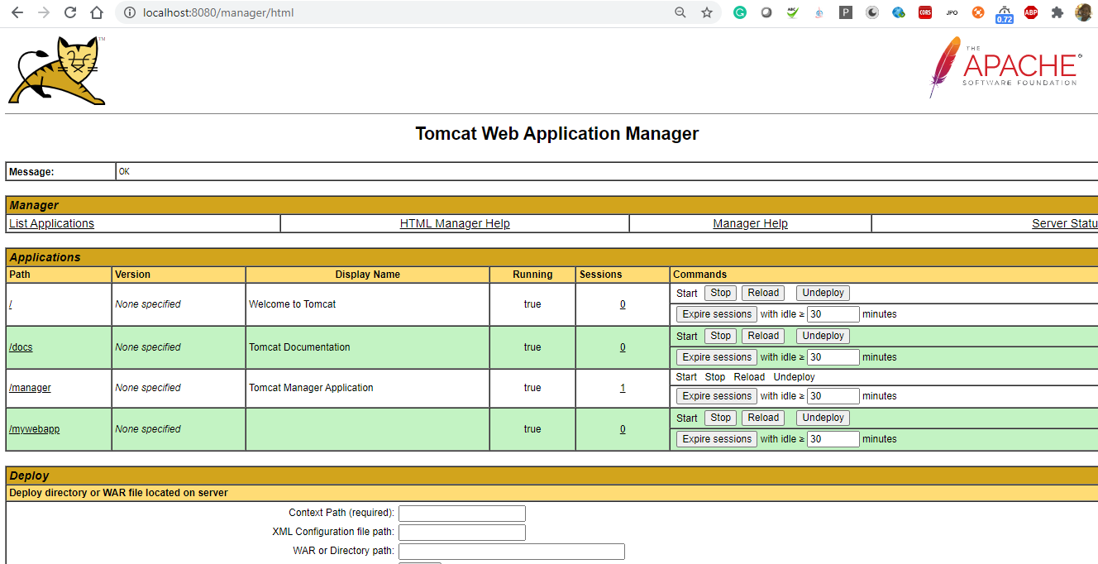
Application Server - TOMCAT
04

Slide 14
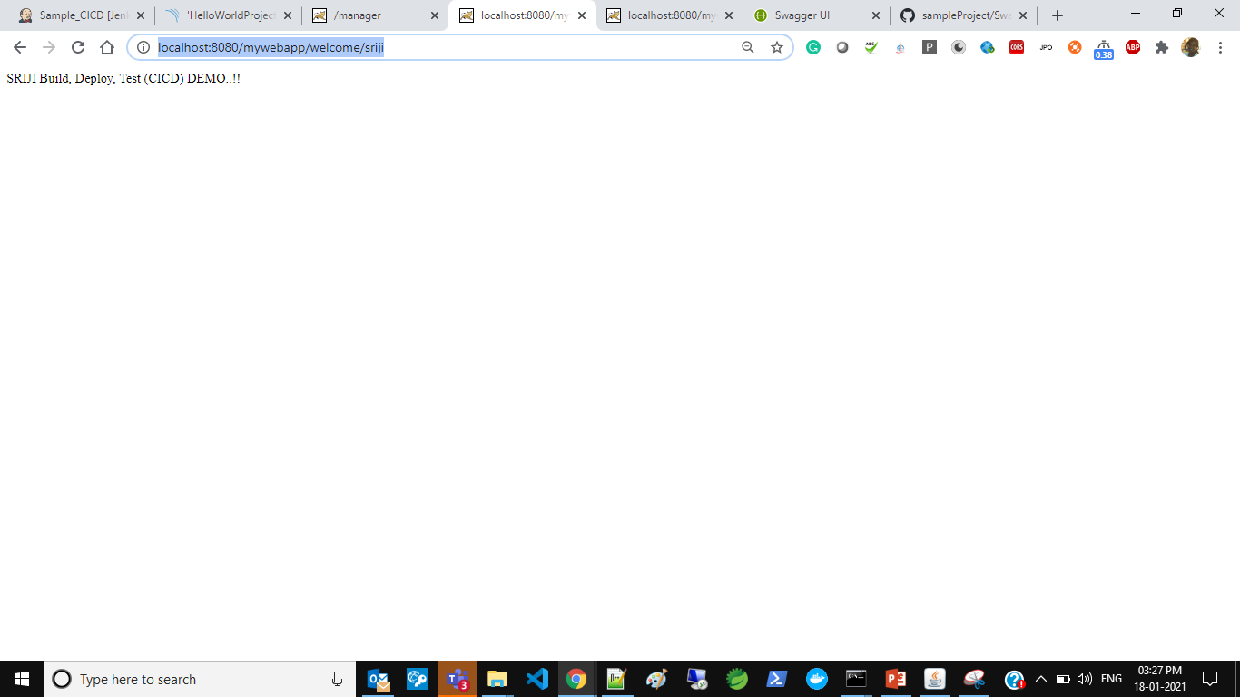
TESTING APPLICATION
04

Slide 15
BENEFITS OF DEVOPS
Ability to manage changing Priorities
Shorter Development Cycle
Higher Quality Standards
Better serve the end-user
Increased Release Velocity
Stable/reliable Operating Environments
Reduced Time to Recover upon Failure.
Improved Defect Detection
04

Slide 16

KG Information Systems Private Limited
THANK YOU
www.kgisl.com

